Slide 1
Expanding the Bellabeat brand
Created by: LaChristian Shepherd
10/9/2022

Slide 2
Problem:
Solution:
View data from similar products in the marketplace to find trends that may be used to help improve the marketing strategy
How can we improve the current user experience and create a marketing strategy that can attract new users?

Slide 3
What are a few things we can do to improve user activity?

Slide 4
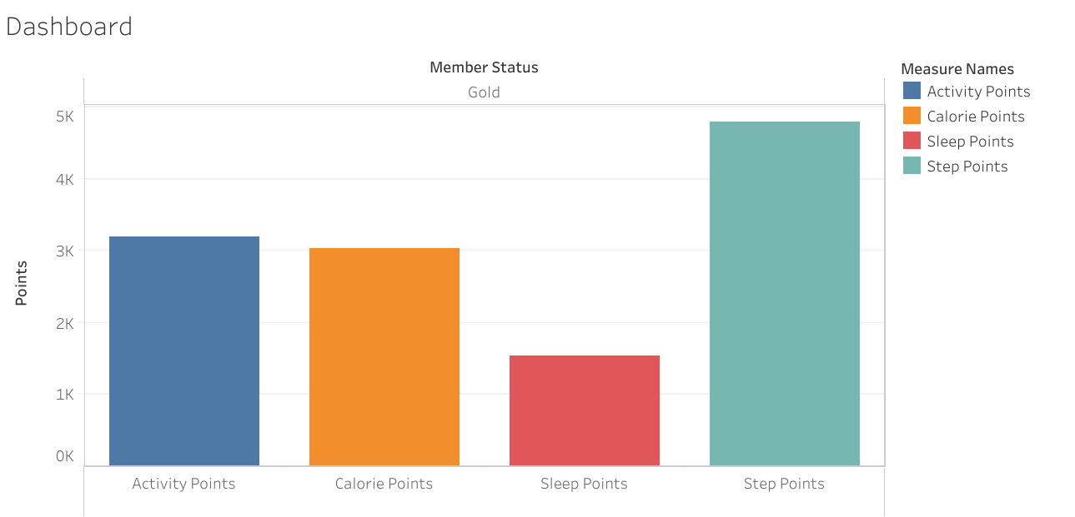
Top user activity
Users can gain up to 800 points per day
A point system may be useful for rewards and discounts in order to earn repeat business
Create badges when milestones are reached

Slide 5
Overall, we found that only 72% of current app users are utilizing the sleep feature, so how do we get them to interact more?

Slide 6
Creating an alarm clock feature; this will encourage more users to use the app and create more user feedback

Slide 7
Another thing we want to look at is the steps taken metric. We've found that there is a high correlation between this, and calories burned. This seems to be a huge attractor for most applications like BellaBeat products.

Slide 8
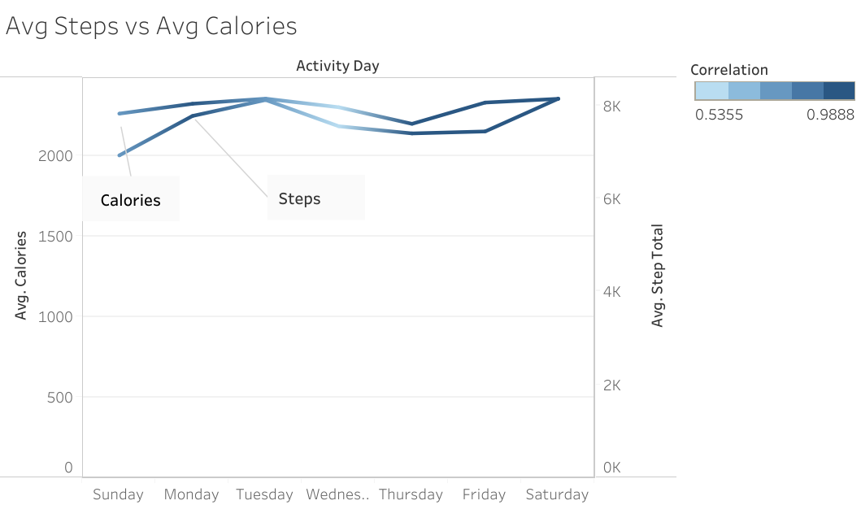
This is the metric with the most entries. Makes sense seeing that it is most closely related to reduce BMI

Slide 9
Now one thing that we don’t see a lot of is community engagement
With this being a primarily women's-based app, I don’t see any sharing of information between users

Slide 10
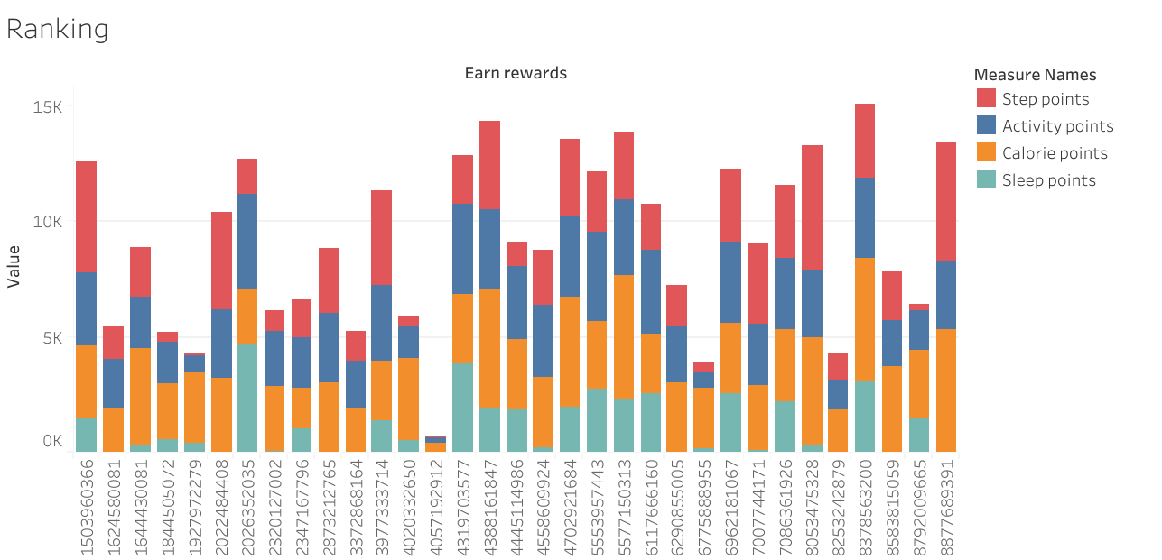
We see here a ranking of the most active users
Being able to rank yourself among your peers is one way to motivate and inspire our current consumer base

Slide 11
Recommendations

Slide 12
Create a rewards program in order to re-target your current audiences
Create marketing campaigns around your most useful metrics
Create a community where others can blog and interact with one another

Slide 13
Continued…

Slide 14
Now its time to show work. The following slides show the queries put together to create the graphs. The data was queried in Google Cloud. The graphs were created in Tabelau

Slide 15
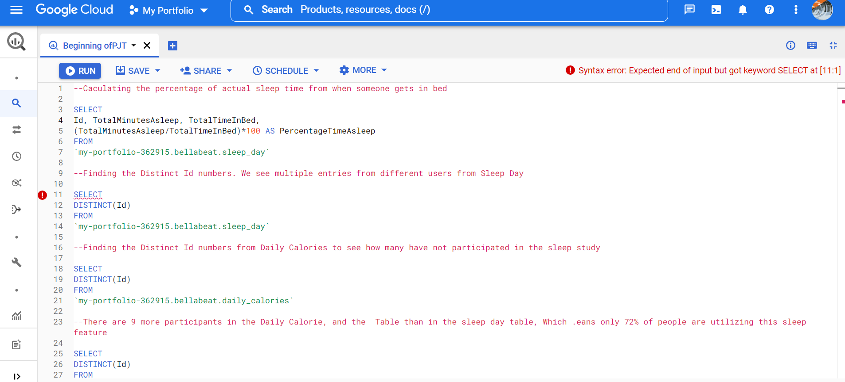

Slide 16
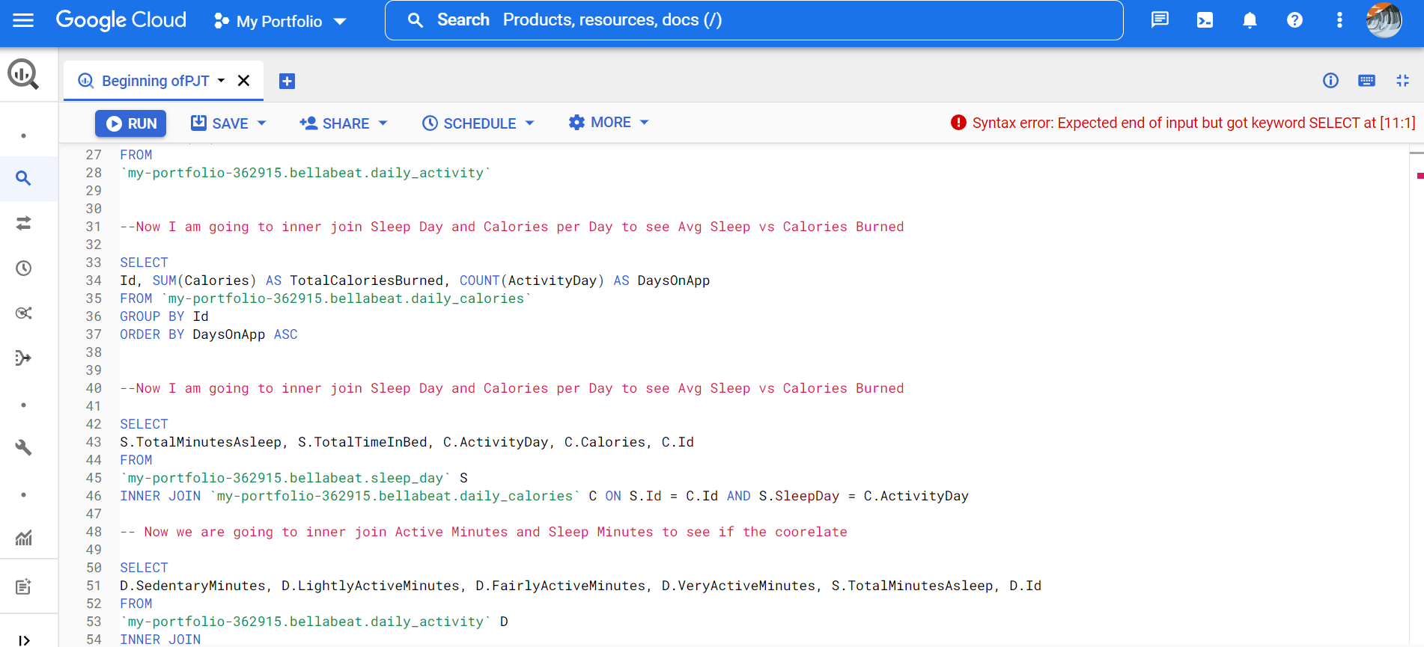

Slide 17
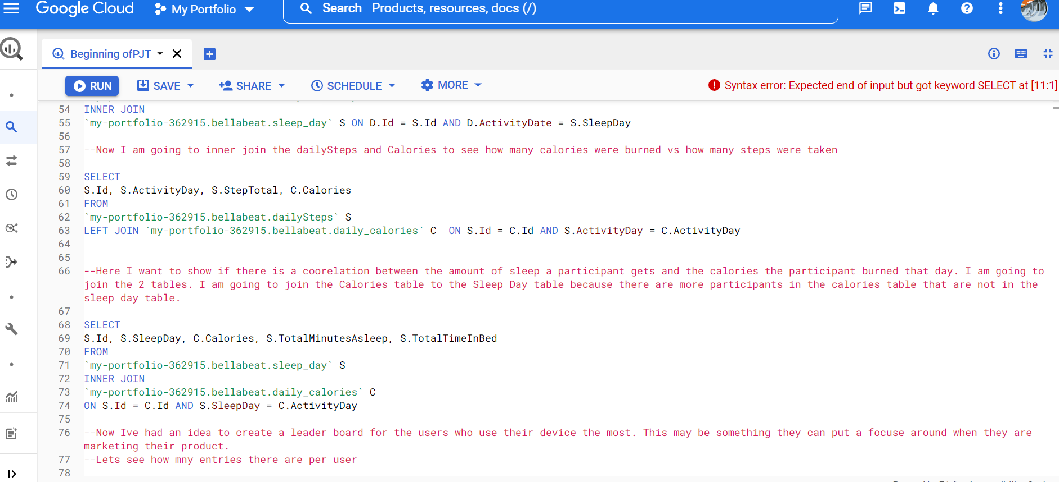

Slide 18
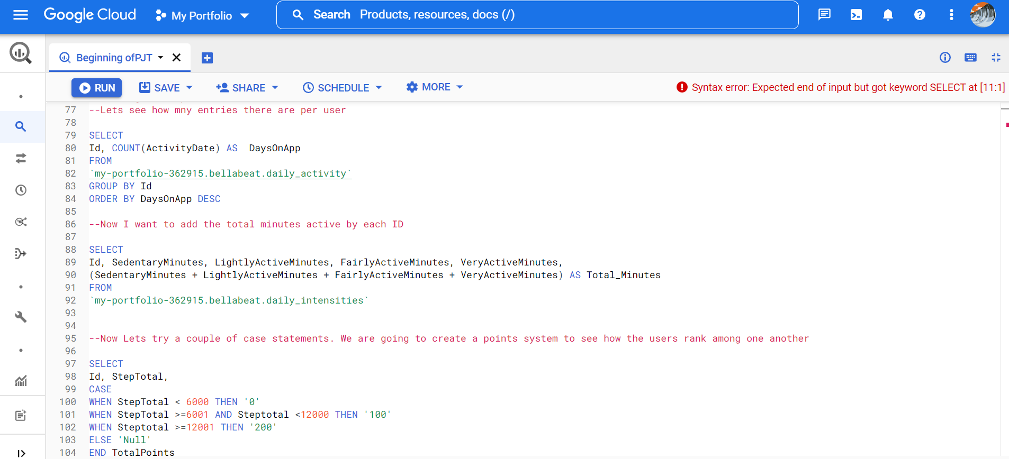

Slide 19
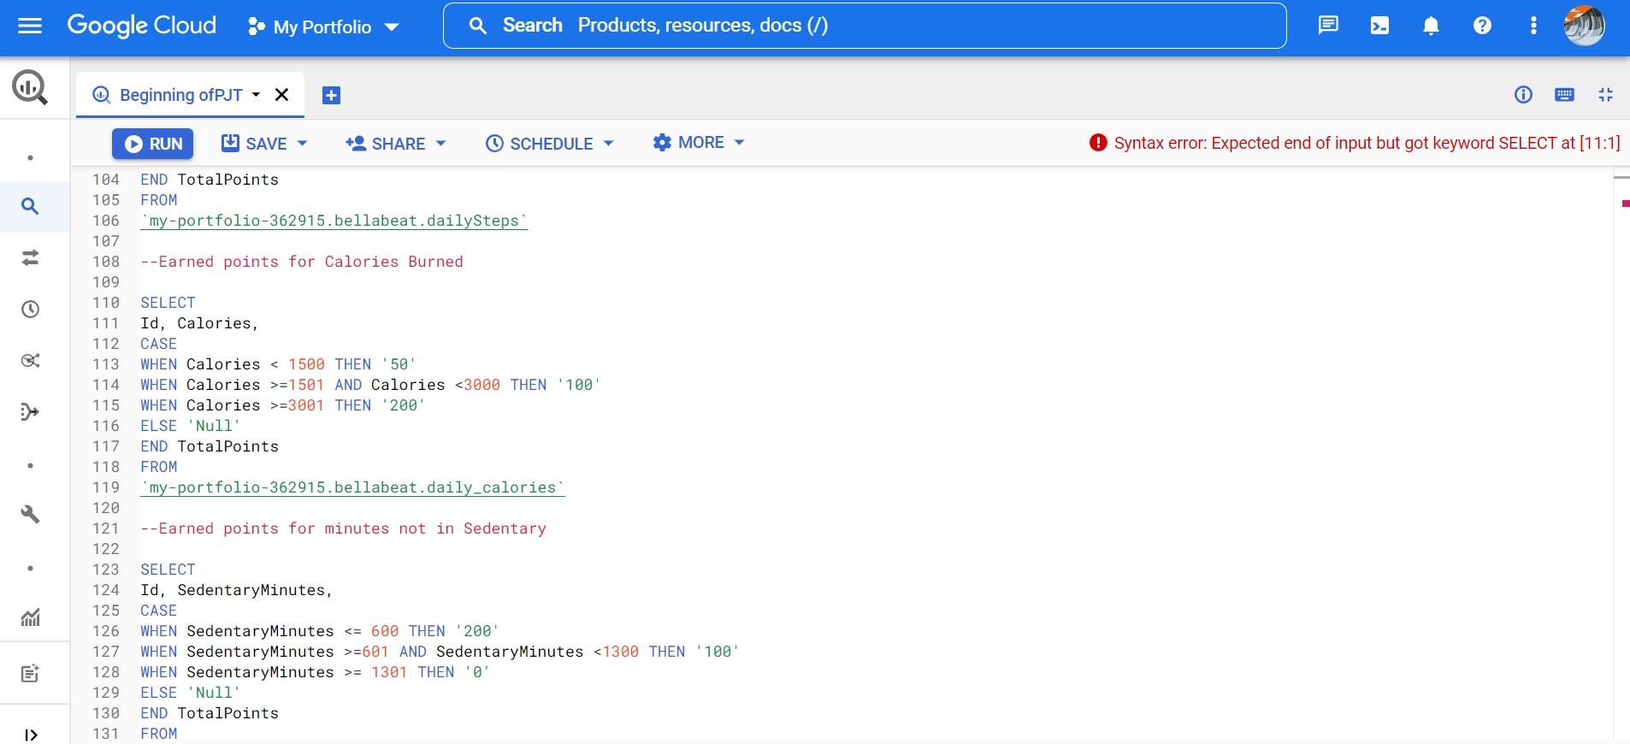

Slide 20
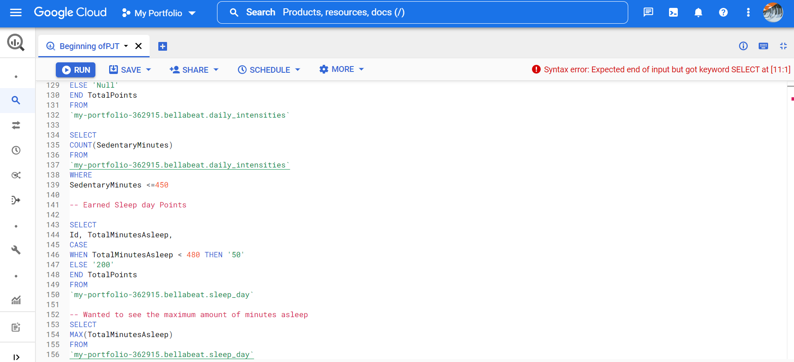

Slide 21
Thank you for your time!

